Slide 1

Discrete
Mathematics
Chapter 10
Trees

Slide 2
Outline
10.1 Introduction to Trees
10.2 Applications of Trees
10.3 Tree Traversal
10.4 Spanning Trees
10.5 Minimal Spanning Trees
Ch10-<number>

Slide 3
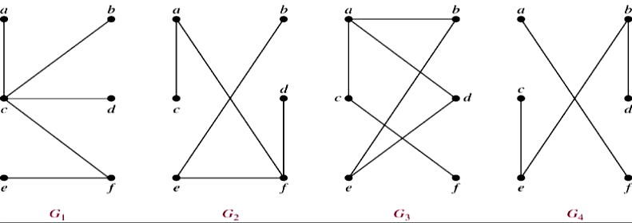
10.1 Introduction to Trees
Def 1 A tree is a connected undirected graph with no
simple circuits.
Example 1. Which of the graphs are trees?
Sol: G₁, G₂
Ch10-<number>

Slide 4
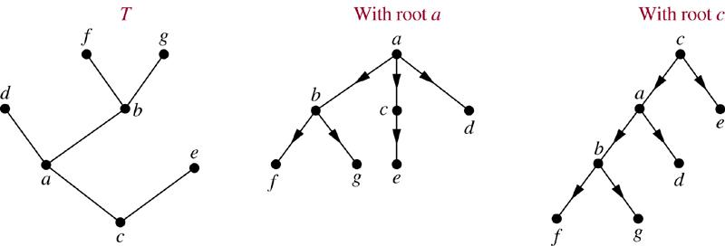
Thm 1. Any undirected graph is a tree if and only if there is a unique simple path between any two of its vertices.
Def 2. A rooted tree is a tree in which one vertex has been designed as the root and every edge is directed away from the root.
Example
Ch10-<number>

Slide 5
Def: a is the parent of b, b is the child of a, c, d, e are siblings, a, b, d are ancestors of f c, d, e, f, g are descendants of b c, e, f, g are leaves of the tree (deg=1) a, b, d are internal vertices of the tree
(at least one child) subtree with d as its root:
a
b
d
c
e
f
g
d
f
g
Ch10-<number>

Slide 6
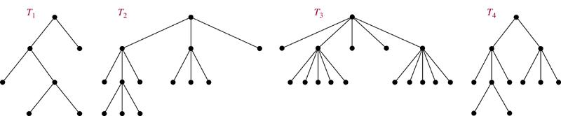
Def 3 A rooted tree is called an m-ary tree if every
internal vetex has no more than m children. The tree
is called a full m-ary tree if every internal vertex has
exactly m children. An m-ary tree with m=2 is called
a binary tree.
Example 3
full binary tree
full 3-ary tree
full 5-ary tree
not full 3-ary tree
Ch10-<number>

Slide 7
Def:
a
b
c
left child of a
d
e
f
right child of c
left subtree of a
right subtree of a
Ch10-<number>

Slide 8
Properties of Trees
Thm 2. A tree with n vertices has n−1 edges.
Pf. (by induction on n)
n = 1 : K₁ is the only tree of order 1, |E(K₁)| = 0. ok!
Assume the result is true for every trees of order n = k.
Let T be a tree of order n = k+1, v be a leaf of T,
and w be the parent of v.
Let T ’ be the tree T− {v}.
∴|V(T ’)| = k, and |E(T ’)| = k−1 by the induction hypothesis.
⇒ |E(T)| = k
By induction, the result is true for all trees. #
Ch10-<number>

Slide 9
Thm 3. A full m-ary tree with i internal vertices contains n = mi + 1 vertices.
Pf. Every vertex, except the root, is the child of an internal vertex.
Each internal vertex has m children.
⇒ there are mi +1 vertices in the tree
Exercise: 19
Cor. A full m-ary tree with n vertices contains
(n−1)/m internal vertices, and hence
n − (n−1)/m = ((m−1)n+1)/m leaves.
Ch10-<number>

Slide 10
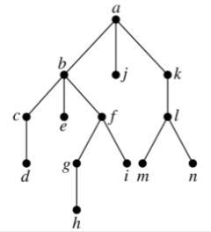
Def: The level of a vertex v in a rooted tree is the length of the unique path from the root to this vertex.
The level of the root is defined to be zero.
The height of a rooted tree is the maximum of the levels of vertices.
Example 10.
level
0
1
height = 4
2
3
4
Ch10-<number>

Slide 11
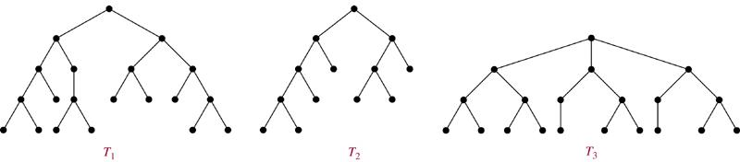
Def: A rooted m-ary tree of height h is balanced if all
leaves are at levels h or h−1.
Example 11 Which of the rooted trees shown below
are balanced?
Sol. T₁, T₃
Thm 5. There are at most m^{h} leaves in an m-ary tree
of height h.
Ch10-<number>

Slide 12
Def: A complete m-ary tree is a full m-ary tree, where every leaf is at the same level.
Ex 28 How many vertices and how many leaves does
a complete m-ary tree of height h have?
Sol.
# of vertices = 1+m+m²+…+m^{h} = (m^{h+1}−1)/(m−1)
# of leaves = m^{h}
Ch10-<number>

Slide 13
10.2 Applications of Trees
Binary Search Trees
Goal: Implement a searching algorithm that finds items efficiently when the items are totally ordered.
Binary Search Tree: Binary tree + each child of a vertex is designed as a right or left child, and each vertex v is labeled with a key label(v), which is one of the items.
Note: label(v) > label(w) if w is in the left subtree of v
and label(v) < label(w) if w is in the right subtree of v
Ch10-<number>

Slide 14
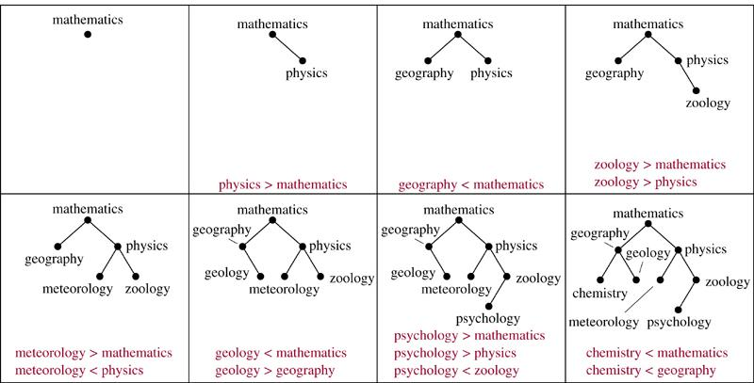
Example 1 Form a binary search tree for the words
mathematics, physics, geography, zoology, meteorology,
geology, psychology, and chemistry (using alphabetical order).
Sol.
Ch10-<number>

Slide 15
Algorithm 1 (Locating and Adding Items to a Binary Search Tree.)
Procedure insertion(T: binary search tree, x: item)
v := root of T
{a vertex not present in T has the value null}
while v ≠ null and label(v) ≠ x
begin
if x < label(v) then
if left child of v ≠ null then v:=left child of v
else add new vertex as a left child of v and set v := null
else
if right child of v ≠ null then v:= right child of v
else add new vertex as a right child of v and set v := null
end
if root of T = null then add a vertex v to the tree and label it with x
else if v is null or label(v) ≠ x then label new vertex with x and
let v be this new vertex
{v = location of x}
Ch10-<number>

Slide 16
Example 2 Use Algorithm 1 to insert the word oceanography into the binary search tree in Example 1.
Sol.
label(v) = mathematics < oceanography
mathematics
label(v) = physics > oceanography
v
label(v) = meteorology < oceanography
geography
physics
meteorology
zoology
chemistry
geology
oceanography
psychology
Exercise: 1,3
Ch10-<number>

Slide 17
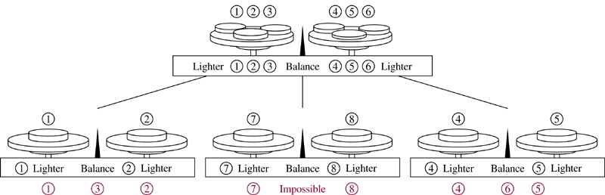
Sol.
⇒ 3-ary tree
Need 8 leaves ⇒
Exercise: 7
Ch10-<number>

Slide 18
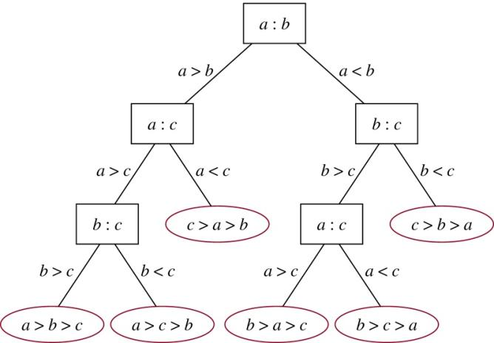
Example 4 A decision tree that orders the elements of the list a, b, c.
Sol.
Ch10-<number>

Slide 19
Prefix Codes
Problem: Using bit strings to encode the letter of the
English alphabet
⇒ each letter needs a bit string of length 5 (因 2⁴ < 26 < 2⁵)
Is it possible to find a coding scheme of these letter
such that when data are coded, fewer bits are used?
Encode letters using varying numbers of bits.
Some methods must be used to determine where the
bits for each character start and end.
⇒ Prefix codes: Codes with the property that the bit string
for a letter never occurs as the first part of the bit string
for another letter.
Ch10-<number>
Notes:
p:\msoffice\My Projects\Rosen 6e 2007\Imagebank\JPEGs07-24-06\ch10\jpeg\10_2_04.jpg

Slide 20
Example: (not prefix code)
e : 0, a : 1, t : 01
The string 0101 could correspond to eat, tea, eaea, or tt.
Example: (prefix code)
e : 0, a : 10, t : 11
The string 10110 is the encoding of ate.
Ch10-<number>

Slide 21
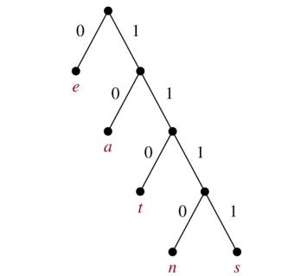
A prefix code can be represented using a binary tree.
character: the label of the leaf
edge label: left child → 0, right child → 1
The bit string used to encode a character is the sequence
of labels of the edges in the unique path from the root to
the leaf that has this character as its label.
Example:
encode
e : 0
a : 10
t : 110
n : 1110
s : 1111
decode
11111011100
s
a
n
e
⇒ sane
Ch10-<number>

Slide 22
Huffman Coding (data compression)
Input the frequencies of symbols in a string and output
a prefix code that encodes the string using the fewest
possible bits, among all possible binary prefix codes for
these symbols.
Ch10-<number>

Slide 23
Algorithm 2 (Huffman Coding)
Procedure Huffman(C: symbols a_{i} with frequencies w_{i}, i = 1, …, n)
F := forest of n rooted trees, each consisting of the single vertex a_{i}
and assigned weighted w_{i}
while F is not a tree
begin
Replace the rooted trees T and T’ of least weights from F with
w(T) ≥ w(T’) with a tree having a new root that has T as its
left subtree and T’ as its right subtree. Label the new edge to T
with 0 and the new edge to T’ with 1.
Assign w(T)+w(T’) as the weight of the new tree.
end
Ch10-<number>

Slide 24
Example 5 Use Huffman coding to encode the following
symbols with the frequencies listed:
A: 0.08, B: 0.10, C: 0.12, D: 0.15, E: 0.20, F: 0.35.
What is the average number of bits used to encode a
character?
Sol:
1.
2. The average number of bits is:
= 3×0.08+ 3×0.10+ 3×0.12+ 3×0.15+2×0.20+2×0.35
=2.45
Exercise : 23
Ch10-<number>

Slide 25
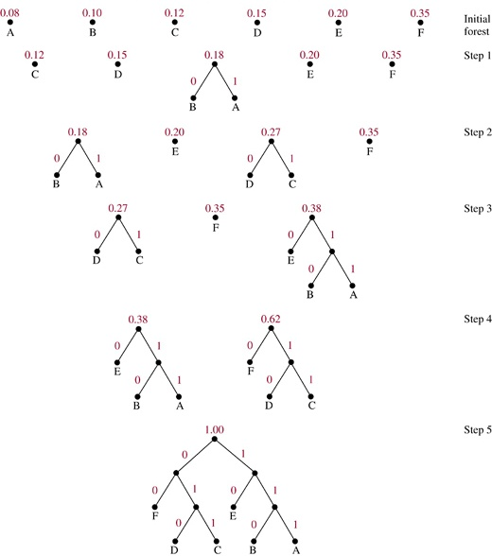
Ch10-<number>

Slide 26
10.3 Tree Traversal
We need procedures for visiting each vertex of an ordered
rooted tree to access data.
Universal Address Systems
Label vertices:
root → 0, its k children → 1, 2, …, k (from left to right)
For each vertex v at level n with label A,
its r children → A.1, A.2, …, A.r (from left to right).
We can totally order the vertices using the lexicographic
ordering of their labels in the universal address system.
x₁.x₂…..x_{n} < y₁.y₂…..y_{m}
if there is an i, 0 ≤ i ≤ n, with x₁=y₁, x₂=y₂, …, x_{i-1}=y_{i-1}, and x_{i}<y_{i};
or if n<m and x_{i}=y_{i} for i=1, 2, …, n.
Ch10-<number>

Slide 27
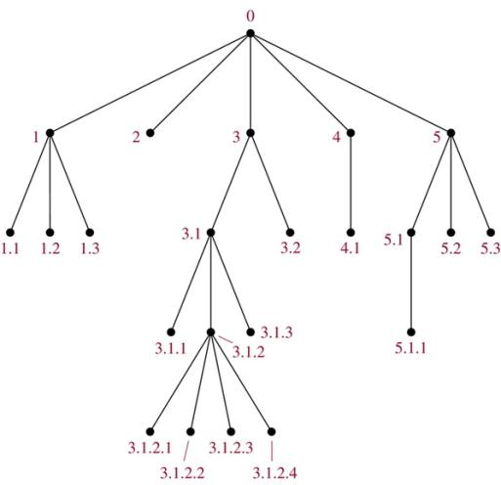
Example 1
The lexicographic ordering is:
0 < 1<1.1 < 1.2 < 1.3 < 2 < 3 < 3.1 < 3.1.1 < 3.1.2 < 3.1.2.1 < 3.1.2.2 < 3.1.2.3 < 3.1.2.4 < 3.1.3 < 3.2 < 4 < 4.1 < 5 < 5.1 < 5.1.1 < 5.2 < 5.3
Exercise : 2
Ch10-<number>

Slide 28
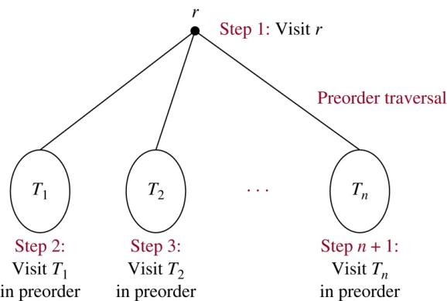
Traversal Algorithms
Preorder traversal (前序)
Ch10-<number>

Slide 29
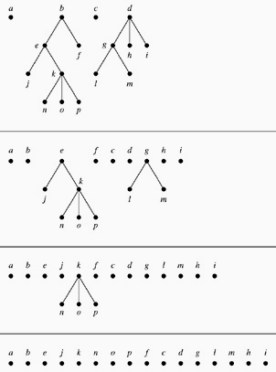
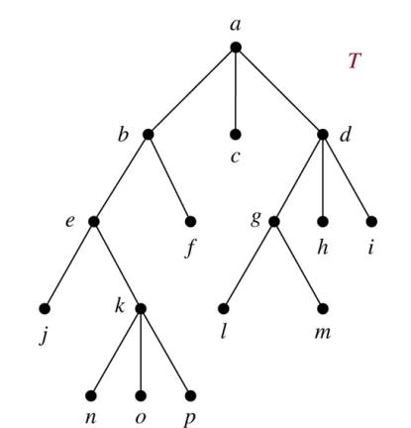
Example 2. In which order does a preorder traversal visit the vertices in the ordered rooted tree T shown below?
Sol:
Ch10-<number>

Slide 30
Algorithm 1 (Preorder Traversal)
Procedure preorder(T: ordered rooted tree)
r := root of T
list r
for each child c of r from left to right
begin
T(c) := subtree with c as its root
preorder(T(c))
end
Exercise : 8
Ch10-<number>

Slide 31
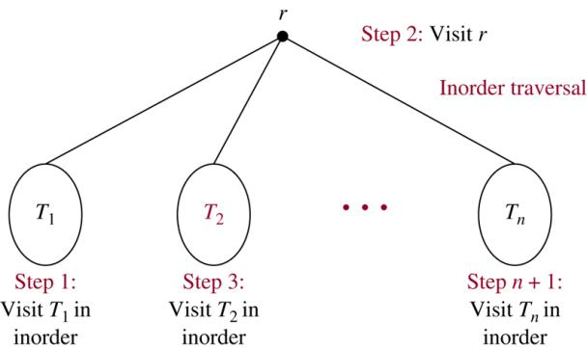
Inorder traversal
Ch10-<number>

Slide 32
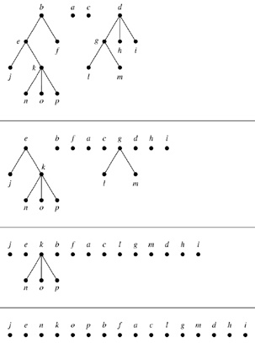
Example 3. In which order does a preorder traversal visit the vertices in the ordered rooted tree T shown below?
Sol:
Ch10-<number>

Slide 33
Algorithm 2 (Inorder Traversal)
Procedure inorder(T: ordered rooted tree)
r := root of T
If r is a leaf then list r
else
begin
l := first child of r from left to right
T(l) := subtree with l as its root
inorder(T(l))
list r
for each child c of r except for l from left to right
T(c) := subtree with c as its root
inorder(T(c))
end
Ch10-<number>

Slide 34
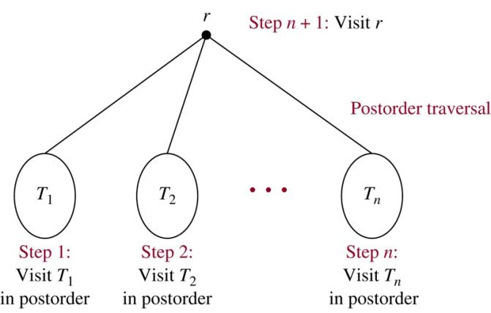
Postorder traversal
Ch10-<number>

Slide 35
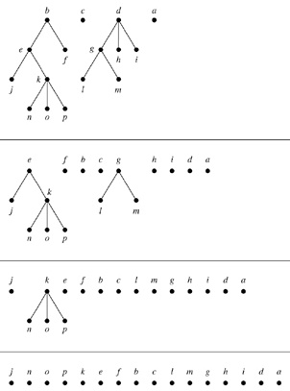
Example 4. In which order does a preorder traversal visit the vertices in the ordered rooted tree T shown below?
Sol:
Ch10-<number>

Slide 36
Algorithm 3 (Postorder Traversal)
Procedure postorder(T: ordered rooted tree)
r := root of T
for each child c of r from left to right
begin
T(c) := subtree with c as its root
postorder(T(c))
end
list r
Ch10-<number>

Slide 37
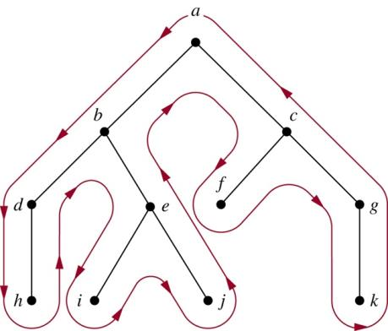
Preorder: curve
Inorder: curve leaf，internal
list
Postorder: curve
Preorder:
a, b, d, h, e, i, j, c, f, g, k
Inorder:
h, d, b, i, e, j, a, f, c, k, g
Postorder:
h, d, i, j, e, b, f, k, g, c, a
Ch10-<number>

Slide 38
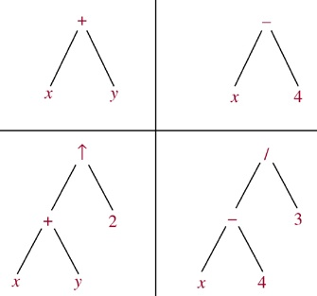
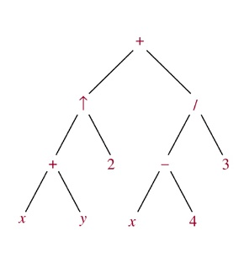
Infix, Prefix, and Postfix Notation
We can represent complicated expressions, such as compound
propositions, combinations of sets, and arithmetic expressions
using ordered rooted trees.
Example 1 Find the ordered rooted tree for
((x+y)↑2)+((x−4)/3). (↑)
Sol.
leaf:
variable
internal vertex:
operation on its left and right subtrees
Ch10-<number>

Slide 39
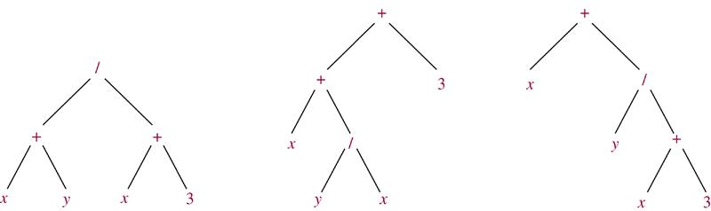
The following binary trees represent the expressions:
(x+y)/(x+3), (x+(y/x))+3, x+(y/(x+3)).
All their inorder traversals lead to x+y/x+3 ⇒ ambiguous
⇒ need parentheses
Infix form: An expression obtained when we traverse its
rooted tree with inorder.
Prefix form: … … by preorder. (also named Polish notation)
Postfix form: … … by postorder. (reverse Polish notation)
Ch10-<number>

Slide 40
Example 6 What is the prefix form for ((x+y)↑2)+((x−4)/3)?
Sol.
+ ↑ + x y 2 / − x 4 3
Example 8 What is the postfix form of the expression
((x+y)↑2)+((x−4)/3)?
Sol.
x y + 2 ↑ x 4 − 3 / +
Note. An expression in prefix form or postfix form is unambiguous, so no parentheses are needed.
Ch10-<number>

Slide 41
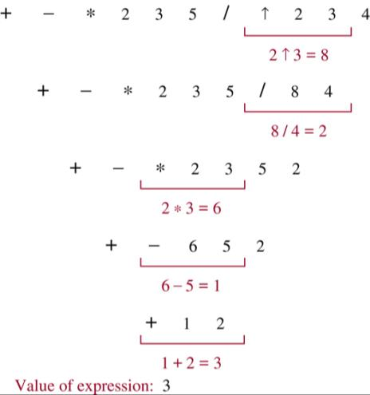
Example 7 What is the value of the prefix expression
+ − * 2 3 5 / ↑ 2 3 4?
Sol.
Ch10-<number>

Slide 42
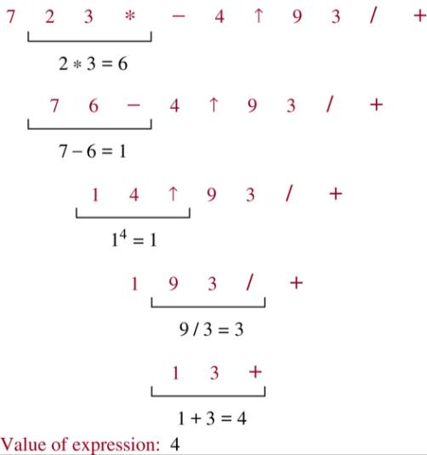
Example 9 What is the value of the postfix expression
7 2 3 * − 4 ↑ 9 3 / +?
Sol.
Ch10-<number>

Slide 43
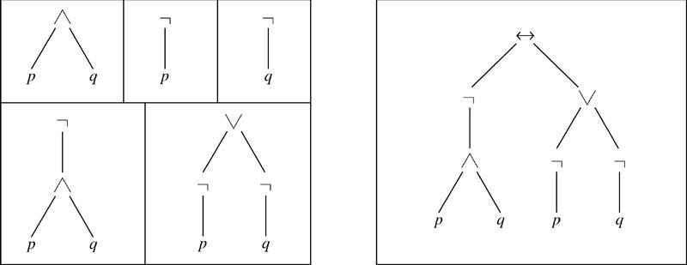
Example 10 Find the ordered rooted tree representing the
compound proposition (¬(p∧q)) ↔ (¬p∨¬q). Then use this
rooted tree to find the prefix, postfix, and infix forms of this
expression.
Sol.
prefix: ↔ ¬ ∧ p q ∨ ¬ p ¬ q
infix: (¬(p∧q)) ↔ ((¬p)∨(¬q))
postfix: p q ∧ ¬ p ¬ q ¬ ∨ ↔
Exercise : 17, 23, 24
Ch10-<number>

Slide 44
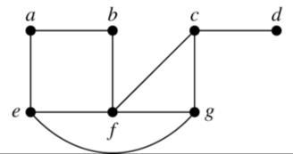
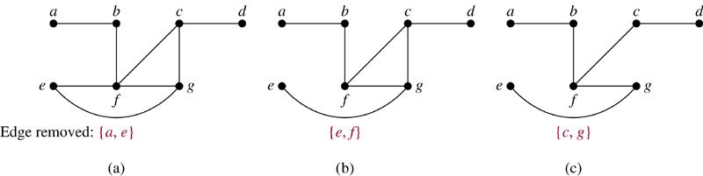
10.4 Spanning Trees
Introduction
Def. Let G be a simple graph. A spanning tree of G is a
subgraph of G that is a tree containing every vertex of G.
Example 1 Find a spanning tree of G.
Sol.
Remove an edge from any circuit.
(repeat until no circuit exists)
Ch10-<number>

Slide 45
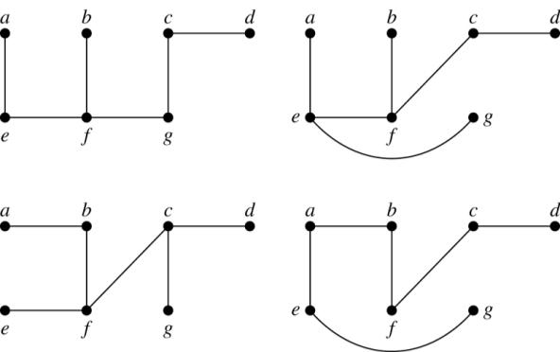
Four spanning trees of G:
Exercise : 1, 8, 11
Thm 1 A simple graph is connected if and only if it has
a spanning tree.
Exercise : 24, 25
Ch10-<number>

Slide 46
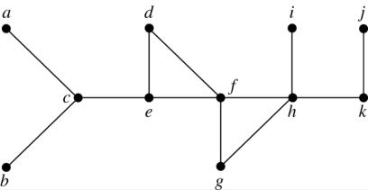
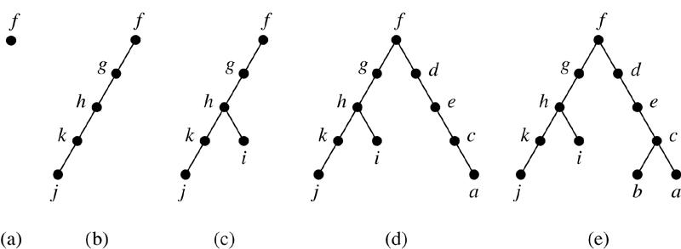
Depth-First Search (DFS)
Example 3 Use depth-first
search to find a spanning tree
for the graph.
Sol. (arbitrarily start with the vertex f)
Ch10-<number>

Slide 47
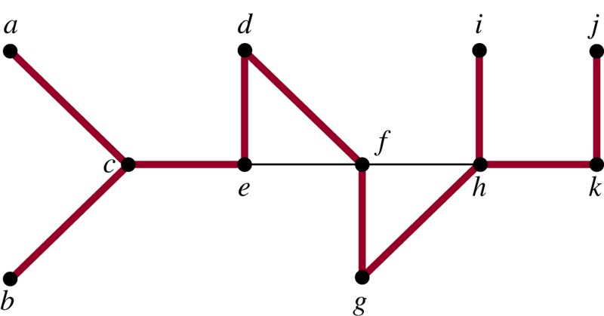
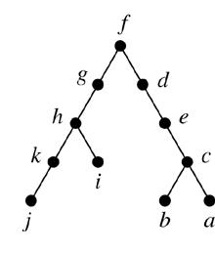
The edges selected by DFS of a graph are called tree
edges. All other edges of the graph must connect a vertex
to an ancestor or descendant of this vertex in the tree.
These edges are called back edges.
Example 4
⇒
The tree edges (red)
and back edges (black)
Ch10-<number>

Slide 48
Algorithm 1 (Depth-First Search)
Procedure DFS(G: connected graph with vertices v₁, v₂, …, v_{n})
T := tree consisting only of the vertex v₁
visit(v₁)
procedure visit(v: vertex of G)
for each vertex w adjacent to v and not yet in T
begin
add vertex w and edge {v, w} to T
visit(w)
end
Exercise : 13
Ch10-<number>

Slide 49
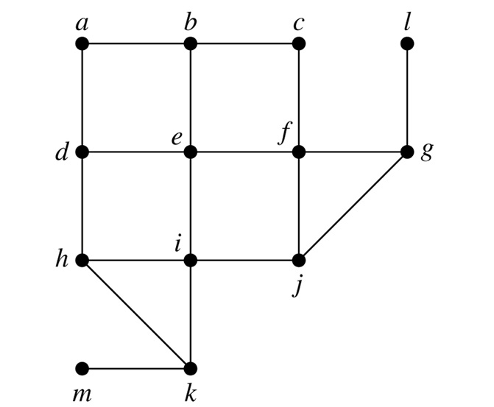
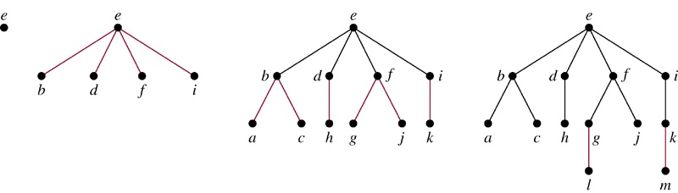
Breadth-First Search (BFS)
Example 5 Use breadth-first search
to find a spanning tree
for the graph.
Sol. (arbitrarily start with the vertex e)
Ch10-<number>

Slide 50
Algorithm 2 (Breadth-First Search)
Procedure BFS(G: connected graph with vertices v₁, v₂, …, v_{n})
T := tree consisting only of vertex v₁
L := empty list
put v₁ in the list L of unprocessed vertices
while L is not empty
begin
remove the first vertex v from L
for each neighbor w of v
if w is not in L and not in T then
begin
add w to the end of the list L
add w and edge {v, w} to T
end
end
Exercise : 16
Ch10-<number>

Slide 51
Backtracking Applications
There are problems that can be solved only by performing an
exhaustive search of all possible solutions.
Decision tree: each internal vertex represents a decision, and
each leaf is a possible solution.
Ch10-<number>

Slide 52
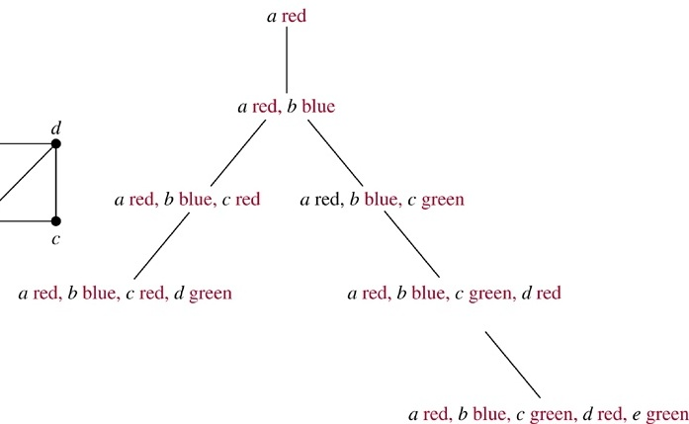
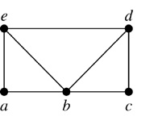
Example 6 (Graph Colorings) How can backtracking be
used to decide whether the following graph can be colored
using 3 colors?
Sol.
Ch10-<number>

Slide 53
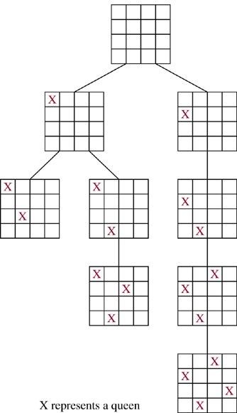
Example 7
(The n-Queens Problem)
The n-queens problem asks how
n queens can be placed on an n×n
chessboard so that no two queens
can attack on another. How can
backtracking be used to solve the
n-queens problem.
Sol.
3rd column
Ch10-<number>

Slide 54
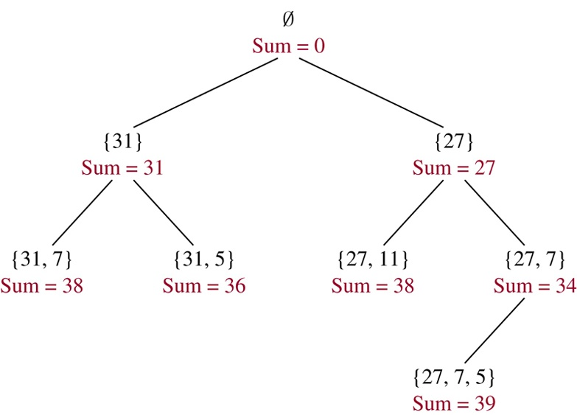
Example 8 (Sum of Subsets)
Give a set S of positive integers x₁, x₂, …, x_{n}, find a subset
of S that has M as its sum. How can backtracking be used to
solve this problem.
Sol.
S = {31, 27, 15, 11, 7, 5}
M = 39
Ch10-<number>

Slide 55
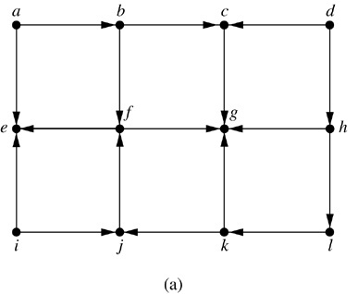
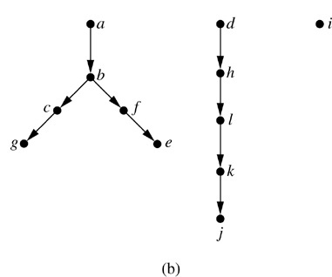
Depth-First Search in Directed Graphs
Example 9 What is the output of DFS given the graph G?
Sol.
Ch10-<number>

Slide 56
10.5 Minimum Spanning Trees
G: connected weighted graph (each edge has an weight ≥ 0)
Def. minimum spanning tree of G: a spanning tree of G
with smallest sum of weights of its edges.
Algorithms for Minimum Spanning Trees
Algorithm 1 (Prim’s Algorithm)
Procedure Prim(G: connected weighted undirected graph with n vertices)
T := a minimum-weight edge
for i := 1 to n−2
begin
e := an edge of minimum weight incident to a vertex in T and not
forming a simple circuit in T if added to T
T := T with e added
end {T is a minimum spanning tree of G}
Ch10-<number>

Slide 57
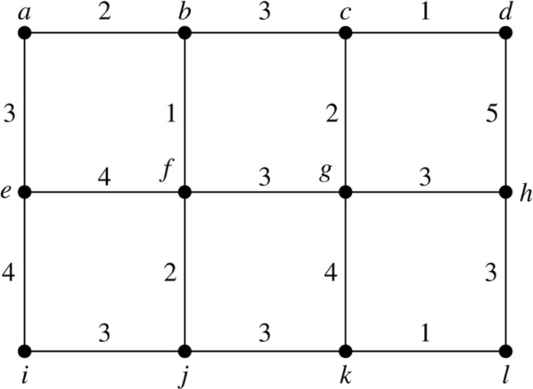
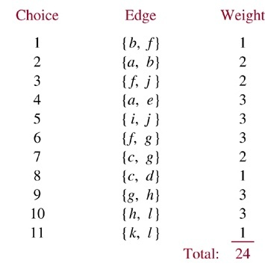
Example 2 Use Prim’s
algorithm to find a minimum
spanning tree of G.
Sol.
Exercise: 3
Ch10-<number>

Slide 58
Algorithm 2 (Kruskal Algorithm)
Procedure Kruskal(G: connected weighted undirected graph with n vertices)
T := empty graph
for i := 1 to n−1
begin
e := any edge in G with smallest weight that does not form a simple
circuit when added to T
T := T with e added
end {T is a minimum spanning tree of G}
Ch10-<number>

Slide 59
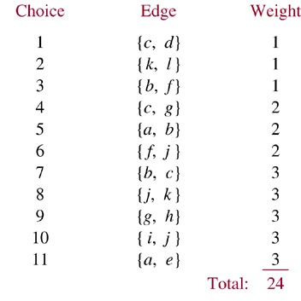
Example 3 Use Kruskal
algorithm to find a minimum
spanning tree of G.
Sol.
Exercise: 7
Ch10-<number>

